Slide 1
Basic Java GUI Structure
CS 5100
Lecture 08

Slide 2
Application Program
Building Blocks
Visual Components
  Table 3.1
  Containers hold, organize, and lay out components
  Non-container components appear within containers, and provide function rather than organization
Non-visual components
  Layout managers
  Models

Slide 3
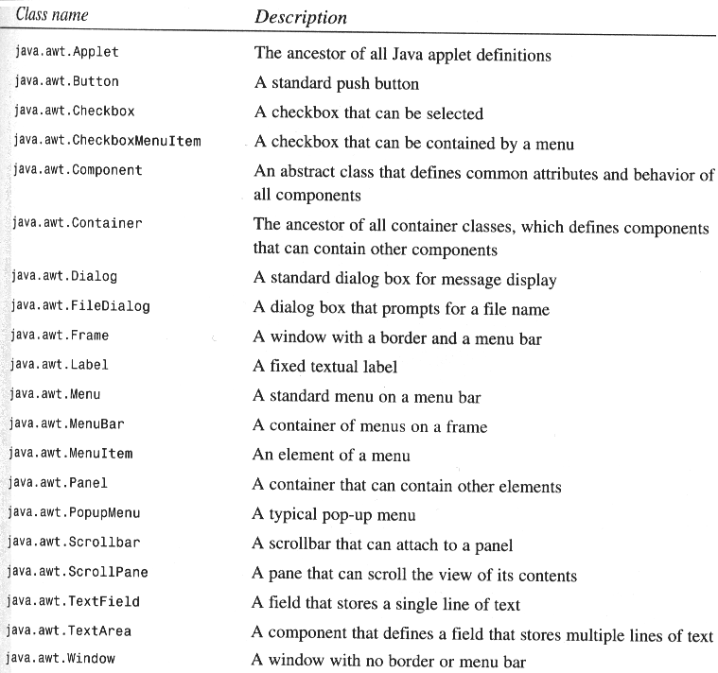

Slide 4
Program Code Structure
Main method is transfer point for the VM
  Creates top-level heavyweight container
  Populates it with other components
  Must be in a class
    Extend Frame or JFrame, main creates a class instance, constructor populates it
    Extend Panel or JInternalFrame, main creates instance and a heavyweight top-level container, populates it with the application
    The second method is more flexible, since the Panel can be included at will in other applications.

Slide 5
Sizing the Application
Override getPreferredSize - recommended way
Pack the container, causing the layout manager to calculate its size based on the preferred sizes of its children
In the absence of a layout manager, user the setBounds method.

Slide 6
Event Handling
Each application should have, at a minimum, a way to quit, which is implemented by a Window Listener
The functionality of the application is supported by creating additional Key, Mouse (Motion), Focus, etc. Listeners to respond to user actions.
Most of the work is in:
  Designing the appearance of the application
  Writing event handlers

Slide 7
Applets
Embedded in HTML page with applet class file name and size
Browser runs VM to construct an outermost container, construct the applet, and start it
Start instead of main method
Init instead of constructor
Stop is called when the applet exits or disappears from the page viewport
Destroy releases resources

Slide 8
Application/Applets
Main class is an extension of Applet or Japplet
But it is given a main method, however
A constructor calls init
The main method usually creates a frame, calls the constructor, calls start, then embeds the constructed applet object in the frame.

